Slide 1

Engineering Education With Extended Reality (XR)
Lightning Presentation
Professor Aveek Dutta, Department of Electrical & Computer Engineering
Joren Cruz, Diego Tapia, Daniel Wang

Slide 2
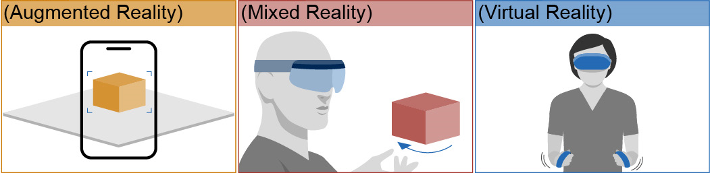
What is Extended Reality (XR)
Augmented
Reality (AR)
Mixed
Reality (MR)
Virtual
Reality (VR)
Glasses or Mobile
External Marker
Digital Overlays
Hybrid
Gesture Controls
Spatial Anchors
Headset
Controllers
Tracking Systems
Notes:
Who is XR?
Each of these is a subset
Key difference is how a user is able to interact with an object based on the platform type
AR is basically just a render
MR is a Visual projection which can be manipulated due to gestures
VR obstructs vision of outside world for an immersive virtual generation

Slide 3
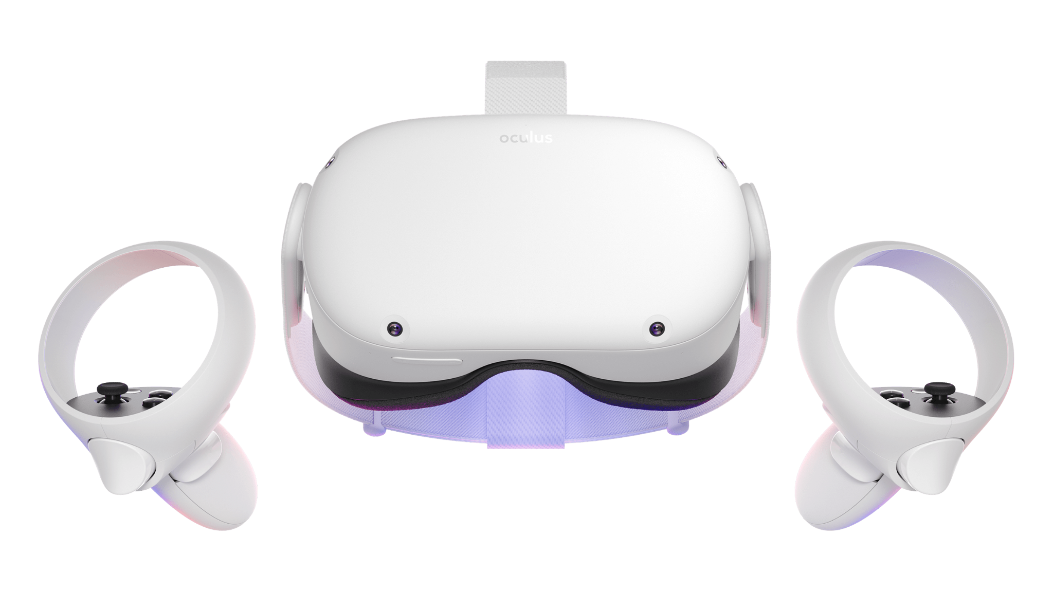
Introduction & Problem Statement
Objective
Importance
Task
Electronics Lab Simulator in Extended Reality
Educational Tool for Learning Basic Circuits
Developing the Initial Analysis Applications
Notes:
Objective
The objective of this capstone project is to build an electronics lab simulator in extended reality​
Like the ECE labs, there will be guided lessons and challenges for you to follow and complete​
Briefly state the importance of the topic or why it should matter to the audience​
XR Lab brings an immersive and experiential domain of learning/education to students, teachers, and "hobbyists" (anyone with a curiosity for electronics)
Task
Gives you something that’s portable
Requires no additional hardware
Offers you your own private workspace
Fully immersive and minimal distractions

Slide 4
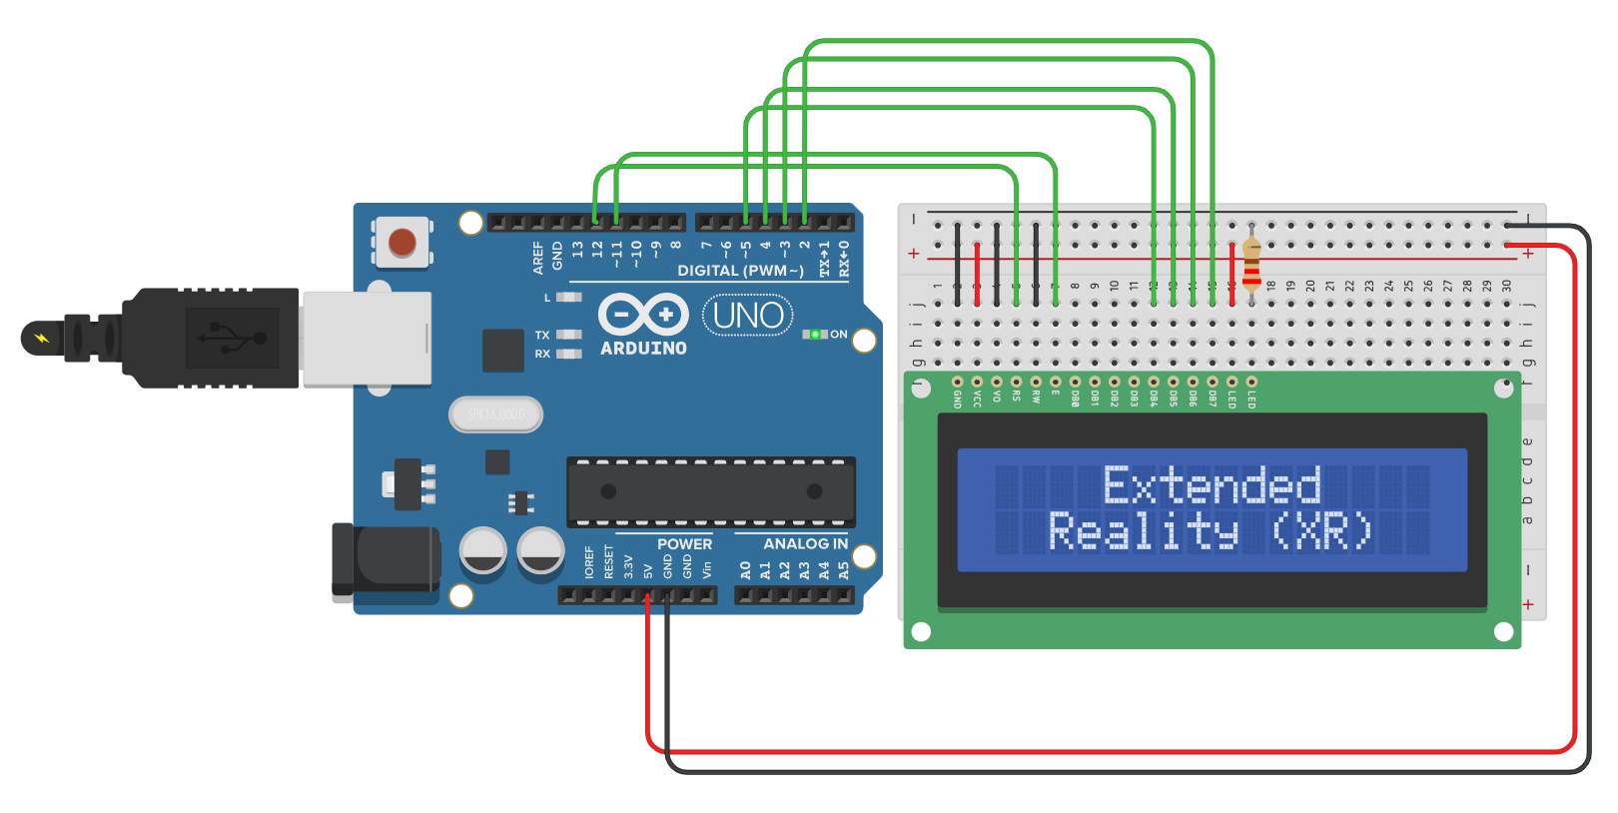
Background & Context
Background:
COVID-era of teaching showed the hardships of remote education
Context:
We’re equipped with the open-source software; Let’s put it all together in one immersive environment.
Notes:
Clearly define the problem or challenge you are addressing​
Tasks for this project include developing initial requirement analysis and hardware/software requirements to build these applications.​
It will involve using some AR/VR equipment and AR/VR development suite for iPhone/android​

Slide 5
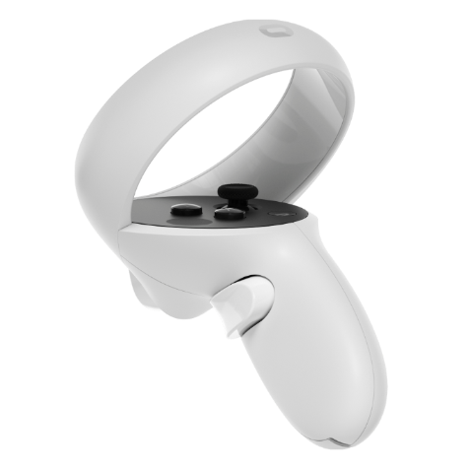

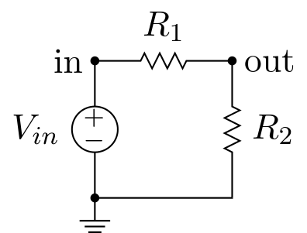
Goals for the Fall & Spring Semester
SPICE Implementation
User Interface
Lay the Groundwork
Define a Circuit, Through a Netlist. Simulate Using Ngspice. Outputing the Analysis.
Beginner Friendly & Intuitive Controls. Specifying Electrical Component Paramaters
Providing Well Written Documentation and Steps Required to Continue Our Progress.
Notes:
JOREN​
Back-End System Analysis of Circuits from Proprietary Software that Generates a Netlist.
DANIEL​
Another thing we wanted to do was implement a user-friendly interface. Something predictable and easy to navigate with clear and concise labels and buttons. That way it’s easy for all age groups to learn. Giving full control to the players. (15 seconds)​
DIEGO​
Providing solid and well documented information will allow future project developers to understand and see at what stage the Learning Tool is at in regards to stability, as well as what requires work.

Slide 6
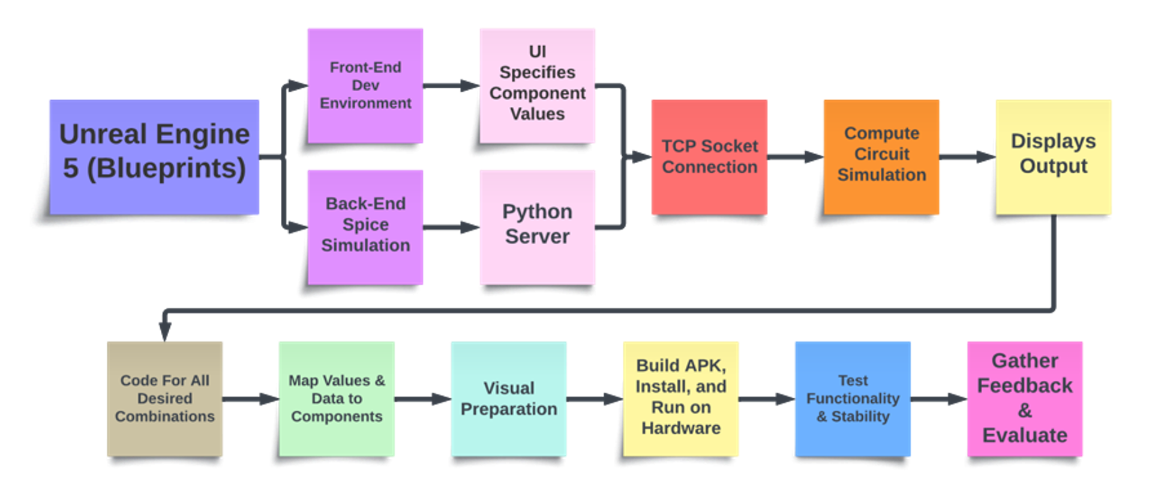
Design
Notes:
Your approach to the problem​
Engineering design process(es) utilized​
Any tools, techniques, or methodologies you have used​
Break down the process into manageable parts if necessary
DANIEL​
We are using the Unreal Engine 5, which uses a visual scripting system called Blueprints. Not only is it intuitive, but it’s quick to implement making it ideal for building and debugging in a completely new environment. We’ve split ​

Slide 7
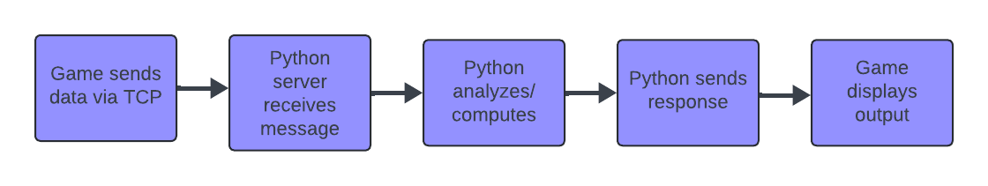


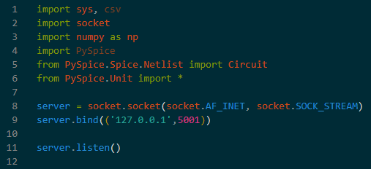


Python Integration with SPICE (Back-End)
Notes:
JOREN
TCP Socket Plugin utilizes Blueprint communication with TCP server coded in Python.
Python, with its extensive libraries, integrates with spice simulators like PySpice.
PySpice is an open-source Python module which interface Python to Ngspice circuit simulators, offering an object-oriented API and converting simulation outputs to Numpy arrays for easy to read data collection.
Together, they create a powerful environment for circuit simulation and communication tasks.​
​
​
​

Slide 8
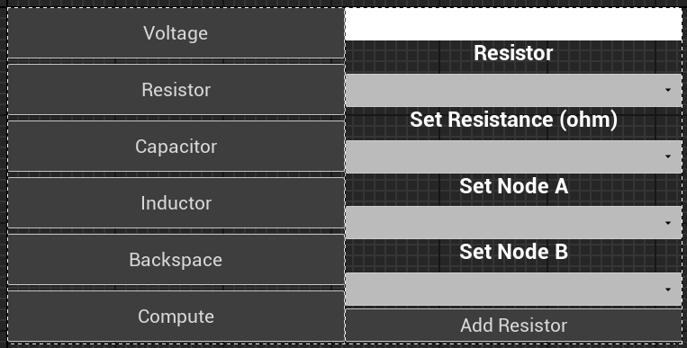
User Interface (Front-End)
Set Specifications for Electrical Components to be Sent to Server
Notes:
DANIEL
Circuit Builder in text that is sent to the server and turned into a readable netlist for PySpice.

Slide 9
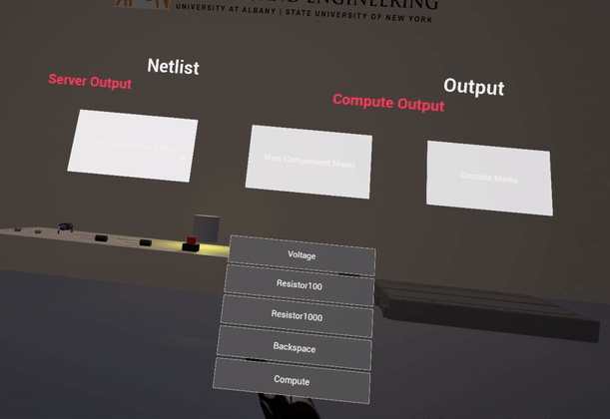
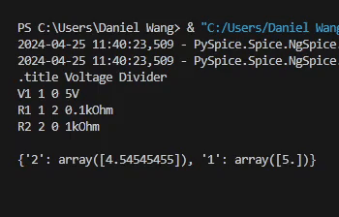
System Demonstration

Slide 10
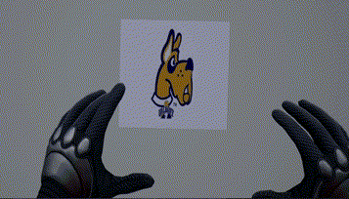
Thank You!

